Slide 1

BBM234 COMPUTER ORGANIZATION

Slide 2
Course Info
Instructors
  Associate Professor Dr. Suleyman Tosun
    Office: Room 210 (Bilisim Institute Floor)
    Phone : 780 75 81
    E-mails: stosun@gmail.com, stosun@hacettepe.edu.tr
    Office hour 1: Tue, 16:00-17:00, room 210
    Office hour 2: Thu, 16:00-17:00, room 210
      If you have urgent issues to solve, e-mail me
      If you need to discuss with me face to face, use office ours or email me to have an appointment
      If it is very urgent, you can stop my office
  Teaching Assistant Selma Dilek

Slide 3
Lecture times
Lectures:
  Section 1: Tuesday, 13:00-15:45, D3
  Section 2: Thursday, 09:00-11:45, D3
    You can attend to the other section if you have an acceptable excuse.

Slide 4
Grading
We will have two midterm and a final exams, one software project and at least three homeworks:
  Two Midterms (50%: 25% each) – Weeks 6 and 11
  Final (40 %)
  Project (4%) and Homeworks (2%each):
    Total of 10 %
    Project will be about writing simple MIPS programs

Slide 5
Academic Dishonesty
Any student caught cheating on an exam or program will automatically fail the course and will be referred to the department chair and/or dean.
When writing programs and doing homework, you may consult with me or the TA at any stage. You may seek help about the MIPS system or the editor from anyone at any time.
To avoid cheating via collaboration, do not show your code and homework to any other classmates.
If a classmate consults you for help after attempting to run his or her program, you may assist in determining why his or her code doesn't work, but refrain from suggesting specific new code.
Do not lead your classmates into temptation: guard your print-outs. We intend to use an automatic cheating-verification program.
Do not even take the risk!..

Slide 6
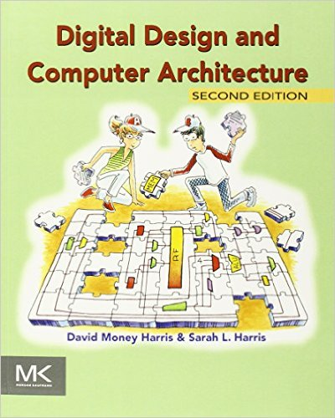
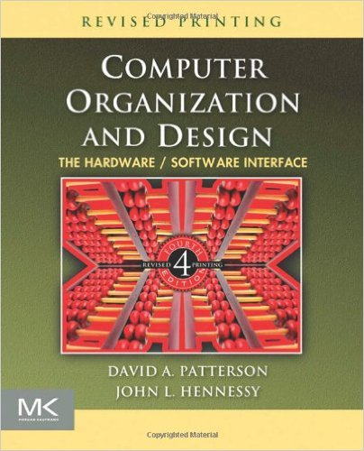
Reference Books
      Digital Design and Computer Architecture, D. Harris, S. Harris, Morgan Kaufmann, 2007.
        We will mention this book as “DDCA”
      Computer Organization and Design: The Hardware/Software Interface, 4th Edition, John L. Hennessy & David A. Patterson, Morgan Kaufmann, 2011.
        We will mention this book as “COD”

Slide 7
Purpose of the Course
  Understand what’s under the hood of a computer
  Design and build a microprocessor
  Learn caches and their effects on performance
  Understand the virtual memory concept
  Learn how I/O systems are dealt with in hardware level (not in OS level)

Slide 8
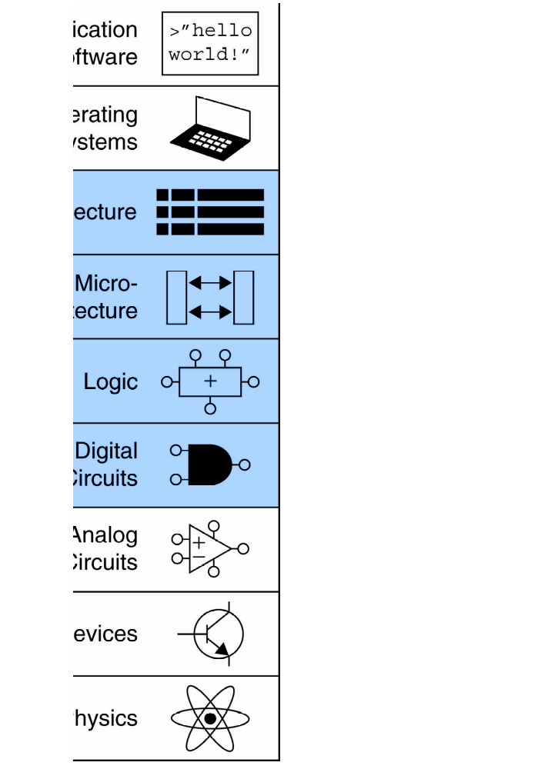
Where is this course in CS?
This course is the follow up course of digital design course.

Slide 9
What You Will Learn
How programs are translated into the machine language
  And how the hardware executes them
The hardware/software interface
What determines program performance
  And how it can be improved
How hardware designers improve performance
What is parallel processing
Notes:
Morgan Kaufmann Publishers
Chapter 1 — Computer Abstractions and Technology

Slide 10
Tentative Schedule
Week # | Topics | Book | Chapter
1 | Introduction:Computer Abstraction and Technology | COD | 1
2 | Digital Building Blocks - Review | DDCA | 5
3-5 | Computer Architecture: MIPS Instruction Set Architecture | DDCA | 6
6 | Midterm 1
7-8 | Microarchitecture: Single-Cycle MIPS Processor | DDCA | 7
9-10 | Microarchitecture: Pipelined MIPS Processor | DDCA | 7
11 | Midterm 2
12-14 | Memory Systems: Memory System Performance Analysis, Caches, Virtual Memory, TLB | DDCA | 8
 | Final
Chapter 1 — Computer Abstractions and Technology — <number>

Slide 11
Course Communication Platform
We will use Piazza
Join the class ASAP
  Go to www.piazza.com
Signup Link:
  piazza.com/hacettepe.edu.tr/spring2018/bbm234
Or - Click on Students Get Started button
Type Hacettepe University
Select Spring 2018
Search BBM234 and
Join the Class

Slide 12
Chapter 1
Computer Abstractions and Technology
Notes:
Morgan Kaufmann Publishers
Chapter 1 — Computer Abstractions and Technology

Slide 13
The Computer Revolution
§1.1 Introduction
Progress in computer technology
  Underpinned by Moore’s Law
    Moore's law is the observation that the number of transistors in a dense integrated circuit doubles approximately every two years
Makes novel applications feasible
  Computers in automobiles
  Cell phones
  Human genome project
  World Wide Web
  Search Engines
Computers are pervasive
Notes:
Morgan Kaufmann Publishers
Chapter 1 — Computer Abstractions and Technology

Slide 14
Classes of Computers
Personal computers
  General purpose, variety of software
  Subject to cost/performance tradeoff
Server computers
  Network based
  High capacity, performance, reliability
  Range from small servers to building sized
Chapter 1 — Computer Abstractions and Technology — <number>
Notes:
Morgan Kaufmann Publishers
Chapter 1 — Computer Abstractions and Technology

Slide 15
Classes of Computers
Supercomputers
  High-end scientific and engineering calculations
  Highest capability but represent a small fraction of the overall computer market
Embedded computers
  Hidden as components of systems
  Stringent power/performance/cost constraints
Chapter 1 — Computer Abstractions and Technology — <number>

Slide 16
Understanding Performance
Algorithm
  Determines number of operations executed
Programming language, compiler, architecture
  Determine number of machine instructions executed per operation
Processor and memory system
  Determine how fast instructions are executed
I/O system (including OS)
  Determines how fast I/O operations are executed
Chapter 1 — Computer Abstractions and Technology — <number>
Notes:
Morgan Kaufmann Publishers
Chapter 1 — Computer Abstractions and Technology

Slide 17








Eight Great Ideas
Design for Moore’s Law
Use abstraction to simplify design
Make the common case fast
Performance via parallelism
Performance via pipelining
Performance via prediction
Hierarchy of memories
Dependability via redundancy
§1.2 Eight Great Ideas in Computer Architecture
Chapter 1 — Computer Abstractions and Technology — <number>

Slide 18

Below Your Program
Application software
  Written in high-level language
System software
  Compiler: translates HLL code to machine code
  Operating System: service code
    Handling input/output
    Managing memory and storage
    Scheduling tasks & sharing resources
Hardware
  Processor, memory, I/O controllers
§1.3 Below Your Program
Chapter 1 — Computer Abstractions and Technology — <number>
Notes:
Morgan Kaufmann Publishers
Chapter 1 — Computer Abstractions and Technology

Slide 19

Levels of Program Code
High-level language
  Level of abstraction closer to problem domain
  Provides for productivity and portability
Assembly language
  Textual representation of instructions
Hardware representation
  Binary digits (bits)
  Encoded instructions and data
Chapter 1 — Computer Abstractions and Technology — <number>
Notes:
Morgan Kaufmann Publishers
Chapter 1 — Computer Abstractions and Technology

Slide 20

Components of a Computer
Same components for
all kinds of computer
  Desktop, server,
  embedded
Input/output includes
  User-interface devices
    Display, keyboard, mouse
  Storage devices
    Hard disk, CD/DVD, flash
  Network adapters
    For communicating with other computers
§1.4 Under the Covers
The BIG Picture
Chapter 1 — Computer Abstractions and Technology — <number>
Notes:
Morgan Kaufmann Publishers
Chapter 1 — Computer Abstractions and Technology

Slide 21
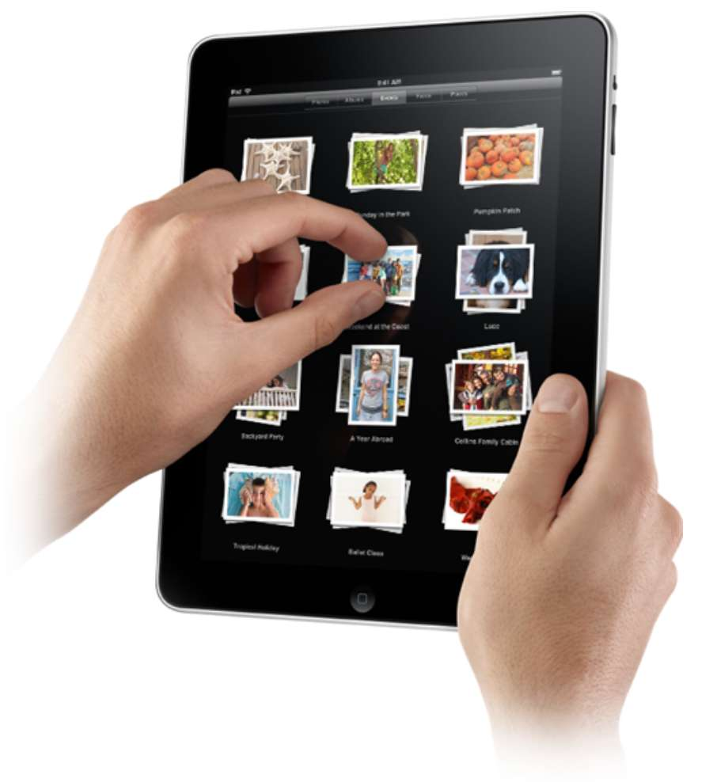
Touchscreen
PostPC device
Supersedes keyboard and mouse
Resistive and Capacitive types
  Most tablets, smart phones use capacitive
  Capacitive allows multiple touches simultaneously
Chapter 1 — Computer Abstractions and Technology — <number>
Notes:
Morgan Kaufmann Publishers
Chapter 1 — Computer Abstractions and Technology

Slide 22

Through the Looking Glass
LCD screen: picture elements (pixels)
  Mirrors content of frame buffer memory
Chapter 1 — Computer Abstractions and Technology — <number>
Notes:
Morgan Kaufmann Publishers
Chapter 1 — Computer Abstractions and Technology

Slide 23
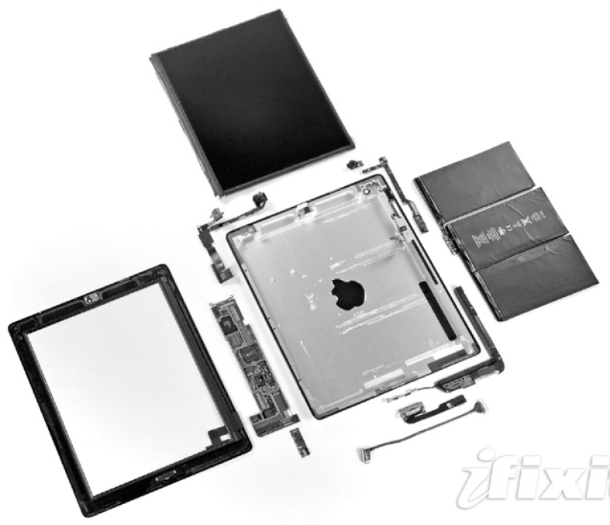
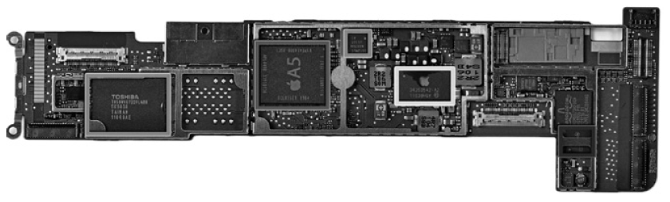
Opening the Box
Capacitive multitouch LCD screen
3.8 V, 25 Watt-hour battery
Computer board
Chapter 1 — Computer Abstractions and Technology — <number>
Notes:
Morgan Kaufmann Publishers
Chapter 1 — Computer Abstractions and Technology

Slide 24
Inside the Processor (CPU)
Datapath: performs operations on data
Control: sequences datapath, memory, ...
Cache memory
  Small fast SRAM memory for immediate access to data
Chapter 1 — Computer Abstractions and Technology — <number>
Notes:
Morgan Kaufmann Publishers
Chapter 1 — Computer Abstractions and Technology

Slide 25
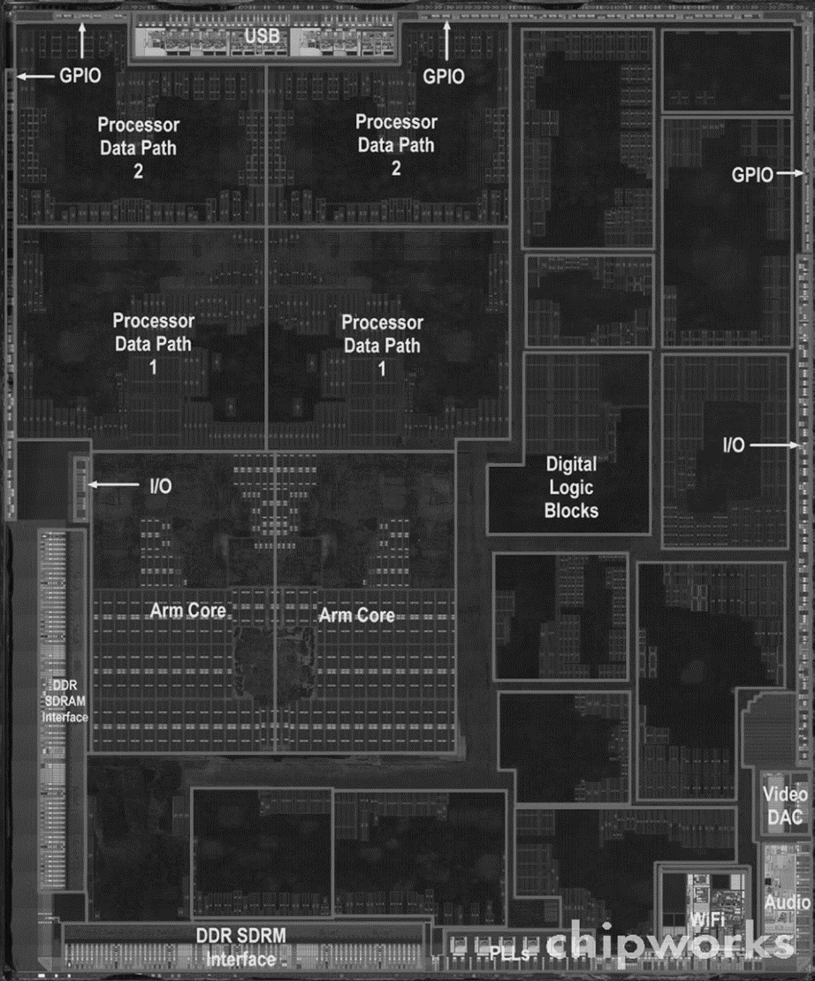
Inside the Processor
Apple A5
Chapter 1 — Computer Abstractions and Technology — <number>
Notes:
Morgan Kaufmann Publishers
Chapter 1 — Computer Abstractions and Technology

Slide 26
Abstractions
The BIG Picture
Abstraction helps us deal with complexity
  Hide lower-level detail
Instruction set architecture (ISA)
  The hardware/software interface
Application binary interface
  The ISA plus system software interface
Implementation
  The details underlying and interface
Chapter 1 — Computer Abstractions and Technology — <number>
Notes:
Morgan Kaufmann Publishers
Chapter 1 — Computer Abstractions and Technology

Slide 27




A Safe Place for Data
Volatile main memory
  Loses instructions and data when power off
Non-volatile secondary memory
  Magnetic disk
  Flash memory
  Optical disk (CDROM, DVD)
Chapter 1 — Computer Abstractions and Technology — <number>
Notes:
Morgan Kaufmann Publishers
Chapter 1 — Computer Abstractions and Technology

Slide 28

Technology Trends
Electronics technology continues to evolve
  Increased capacity and performance
  Reduced cost
§1.5 Technologies for Building Processors and Memory
DRAM capacity
Year | Technology | Relative performance/cost
1951 | Vacuum tube | 1
1965 | Transistor | 35
1975 | Integrated circuit (IC) | 900
1995 | Very large scale IC (VLSI) | 2,400,000
2013 | Ultra large scale IC | 250,000,000,000
Chapter 1 — Computer Abstractions and Technology — <number>
Notes:
Morgan Kaufmann Publishers
Chapter 1 — Computer Abstractions and Technology

Slide 29
Semiconductor Technology
Silicon: semiconductor
Add materials to transform properties:
  Conductors
  Insulators
  Switch
Chapter 1 — Computer Abstractions and Technology — <number>

Slide 30

Manufacturing ICs
Yield: proportion of working dies per wafer
Chapter 1 — Computer Abstractions and Technology — <number>
Notes:
Morgan Kaufmann Publishers
Chapter 1 — Computer Abstractions and Technology

Slide 31

IC Manufacturing Steps

Slide 32

Intel Core i7 Wafer
300mm wafer, 280 chips, 32nm technology
Each chip is 20.7 x 10.5 mm
Chapter 1 — Computer Abstractions and Technology — <number>
Notes:
Morgan Kaufmann Publishers
Chapter 1 — Computer Abstractions and Technology

Slide 33




Defining Performance
§1.6 Performance
Which airplane has the best performance?
Chapter 1 — Computer Abstractions and Technology — <number>
Notes:
Morgan Kaufmann Publishers
Chapter 1 — Computer Abstractions and Technology

Slide 34
Response Time and Throughput
Response time
  How long it takes to do a task
Throughput
  Total work done per unit time
    e.g., tasks/transactions/… per hour
How are response time and throughput affected by
  Replacing the processor with a faster version?
  Adding more processors?
We’ll focus on response time for now…
Chapter 1 — Computer Abstractions and Technology — <number>
Notes:
Morgan Kaufmann Publishers
Chapter 1 — Computer Abstractions and Technology

Slide 35

Relative Performance
Define Performance = 1/Execution Time
“X is n time faster than Y”
Example: time taken to run a program
  10s on A, 15s on B
  Execution Time_{B} / Execution Time_{A}
  = 15s / 10s = 1.5
  So A is 1.5 times faster than B
Chapter 1 — Computer Abstractions and Technology — <number>
Notes:
Morgan Kaufmann Publishers
Chapter 1 — Computer Abstractions and Technology

Slide 36
Measuring Execution Time
Elapsed time
  Total response time, including all aspects
    Processing, I/O, OS overhead, idle time
  Determines system performance
CPU time
  Time spent processing a given job
    Discounts I/O time, other jobs’ shares
  Comprises user CPU time and system CPU time
  Different programs are affected differently by CPU and system performance
Chapter 1 — Computer Abstractions and Technology — <number>
Notes:
Morgan Kaufmann Publishers
Chapter 1 — Computer Abstractions and Technology

Slide 37
CPU Clocking
Operation of digital hardware governed by a constant-rate clock
Clock period
Clock (cycles)
Data transfer
and computation
Update state
Clock period: duration of a clock cycle
  e.g., 250ps = 0.25ns = 250×10^{–12}s
Clock frequency (rate): cycles per second
  e.g., 4.0GHz = 4000MHz = 4.0×10⁹Hz
Chapter 1 — Computer Abstractions and Technology — <number>
Notes:
Morgan Kaufmann Publishers
Chapter 1 — Computer Abstractions and Technology

Slide 38

CPU Time
Performance improved by
  Reducing number of clock cycles
  Increasing clock rate
  Hardware designer must often trade off clock rate against cycle count
Chapter 1 — Computer Abstractions and Technology — <number>
Notes:
Morgan Kaufmann Publishers
Chapter 1 — Computer Abstractions and Technology

Slide 39

CPU Time Example
Computer A: 2GHz clock, 10s CPU time
Designing Computer B
  Aim for 6s CPU time
  Can do faster clock, but causes 1.2 × clock cycles
How fast must Computer B clock be?
Chapter 1 — Computer Abstractions and Technology — <number>
Notes:
Morgan Kaufmann Publishers
Chapter 1 — Computer Abstractions and Technology

Slide 40

Instruction Count and CPI
Instruction Count for a program
  Determined by program, ISA and compiler
Average cycles per instruction
  Determined by CPU hardware
  If different instructions have different CPI
    Average CPI affected by instruction mix
Chapter 1 — Computer Abstractions and Technology — <number>
Notes:
Morgan Kaufmann Publishers
Chapter 1 — Computer Abstractions and Technology

Slide 41

CPI Example
Computer A: Cycle Time = 250ps, CPI = 2.0
Computer B: Cycle Time = 500ps, CPI = 1.2
Same ISA
Which is faster, and by how much?
A is faster…
…by this much
Chapter 1 — Computer Abstractions and Technology — <number>
Notes:
Morgan Kaufmann Publishers
Chapter 1 — Computer Abstractions and Technology

Slide 42
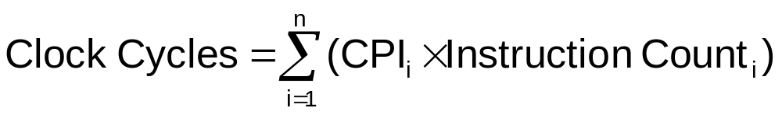

CPI in More Detail
If different instruction classes take different numbers of cycles
Weighted average CPI
Relative frequency
Chapter 1 — Computer Abstractions and Technology — <number>
Notes:
Morgan Kaufmann Publishers
Chapter 1 — Computer Abstractions and Technology

Slide 43
CPI Example
Alternative compiled code sequences using instructions in classes A, B, C
Class | A | B | C
CPI for class | 1 | 2 | 3
IC in sequence 1 | 2 | 1 | 2
IC in sequence 2 | 4 | 1 | 1
Sequence 1: IC = 5
  Clock Cycles
  = 2×1 + 1×2 + 2×3
  = 10
  Avg. CPI = 10/5 = 2.0
Sequence 2: IC = 6
  Clock Cycles
  = 4×1 + 1×2 + 1×3
  = 9
  Avg. CPI = 9/6 = 1.5
Chapter 1 — Computer Abstractions and Technology — <number>
Notes:
Morgan Kaufmann Publishers
Chapter 1 — Computer Abstractions and Technology

Slide 44

Performance Summary
The BIG Picture
Performance depends on
  Algorithm: affects IC, possibly CPI
  Programming language: affects IC, CPI
  Compiler: affects IC, CPI
  Instruction set architecture: affects IC, CPI, T_{c}
Chapter 1 — Computer Abstractions and Technology — <number>
Notes:
Morgan Kaufmann Publishers
Chapter 1 — Computer Abstractions and Technology

Slide 45

Power Trends
§1.7 The Power Wall
In CMOS IC technology
×30
5V → 1V
×1000
Chapter 1 — Computer Abstractions and Technology — <number>
Notes:
Morgan Kaufmann Publishers
Chapter 1 — Computer Abstractions and Technology

Slide 46

Reducing Power
Suppose a new CPU has
  85% of capacitive load of old CPU
  15% voltage and 15% frequency reduction
The power wall
  We can’t reduce voltage further
  We can’t remove more heat
How else can we improve performance?
Chapter 1 — Computer Abstractions and Technology — <number>
Notes:
Morgan Kaufmann Publishers
Chapter 1 — Computer Abstractions and Technology

Slide 47

Uniprocessor Performance
§1.8 The Sea Change: The Switch to Multiprocessors
Constrained by power, instruction-level parallelism, memory latency
Chapter 1 — Computer Abstractions and Technology — <number>
Notes:
Morgan Kaufmann Publishers
Chapter 1 — Computer Abstractions and Technology

Slide 48
Multiprocessors
Multicore microprocessors
  More than one processor per chip
Requires explicitly parallel programming
  Compare with instruction level parallelism
    Hardware executes multiple instructions at once
    Hidden from the programmer
  Hard to do
    Programming for performance
    Load balancing
    Optimizing communication and synchronization
Chapter 1 — Computer Abstractions and Technology — <number>
Notes:
Morgan Kaufmann Publishers
Chapter 1 — Computer Abstractions and Technology

Slide 49

SPEC CPU Benchmark
Programs used to measure performance
  Supposedly typical of actual workload
Standard Performance Evaluation Corp (SPEC)
  Develops benchmarks for CPU, I/O, Web, …
SPEC CPU2006
  Elapsed time to execute a selection of programs
    Negligible I/O, so focuses on CPU performance
  Normalize relative to reference machine
  Summarize as geometric mean of performance ratios
    CINT2006 (integer) and CFP2006 (floating-point)
Chapter 1 — Computer Abstractions and Technology — <number>
Notes:
Morgan Kaufmann Publishers
Chapter 1 — Computer Abstractions and Technology

Slide 50

CINT2006 for Intel Core i7 920
Chapter 1 — Computer Abstractions and Technology — <number>
Notes:
Morgan Kaufmann Publishers
Chapter 1 — Computer Abstractions and Technology

Slide 51
Concluding Remarks
Cost/performance is improving
  Due to underlying technology development
Hierarchical layers of abstraction
  In both hardware and software
Instruction set architecture
  The hardware/software interface
Execution time: the best performance measure
Power is a limiting factor
  Use parallelism to improve performance
§1.9 Concluding Remarks
Chapter 1 — Computer Abstractions and Technology — <number>
Notes:
Morgan Kaufmann Publishers
Chapter 1 — Computer Abstractions and Technology

